Slide 1
07
Discrete Mathematics
“Proving” logical Equivalences with Truth Tables

Slide 2
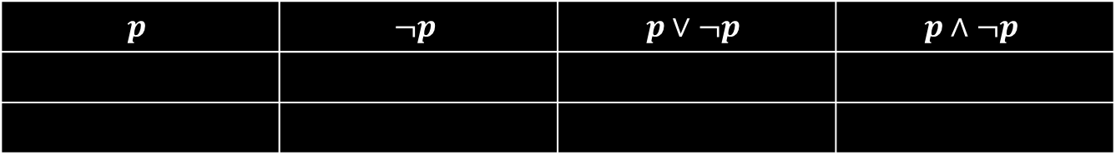

Some Terminology
$$p$$ | $$¬p$$ | $$p∨¬p$$ | $$p∧¬p$$
A tautology is a proposition which is always true. Example: $p∨¬p$
A contradiction is a proposition which is always false. Example: $p∧¬p$
A contingency is a proposition which is neither a tautology nor a contradiction. Example: $p$.

Slide 3
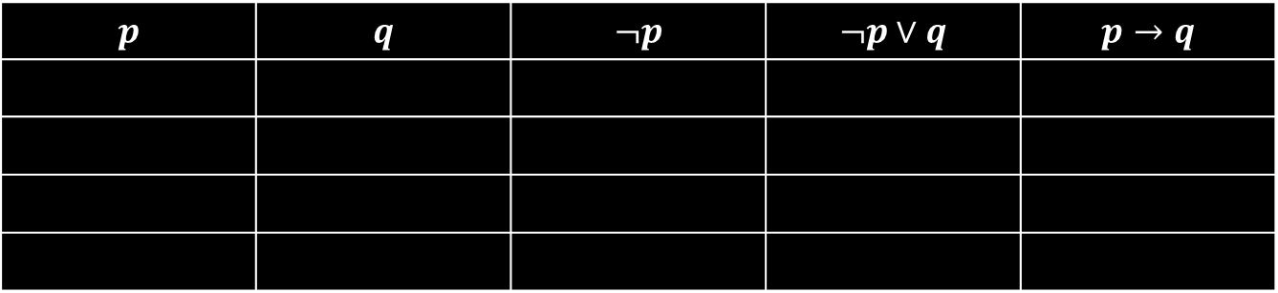

Logical Equivalences
Two compound propositions $p$ and$q$are logically equivalent if $p↔q$ is a tautology, meaning they have the same truth value in all possible cases.
We write this as $p≡q$ where p and q are compound propositions.
Let’s use this truth table to show that $¬p ∨q ≡ p→ q$
$$p$$ | $$q$$ | $$¬p$$ | $$¬p∨q$$ | $$p→q$$

Slide 4
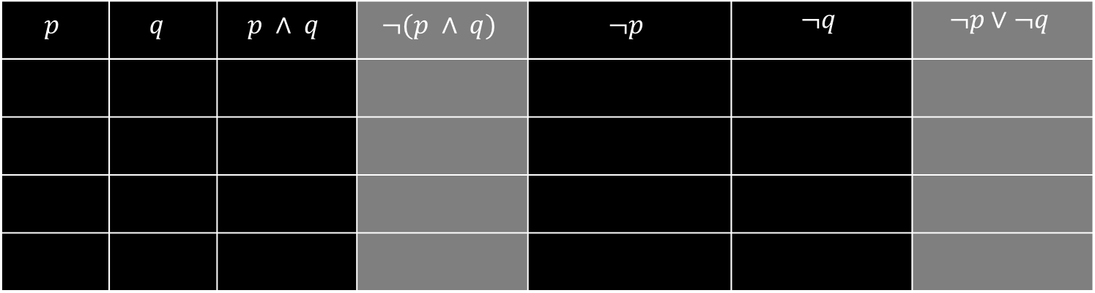

Practice
Determine if $¬(p∧q)$ $≡$ $¬p∨¬q$.
$$p$$ | $$q$$ | $$p ∧ q$$ | $$¬(p ∧ q)$$ | $$¬p$$ | $$¬q$$ | $$¬p∨¬q$$

Slide 5
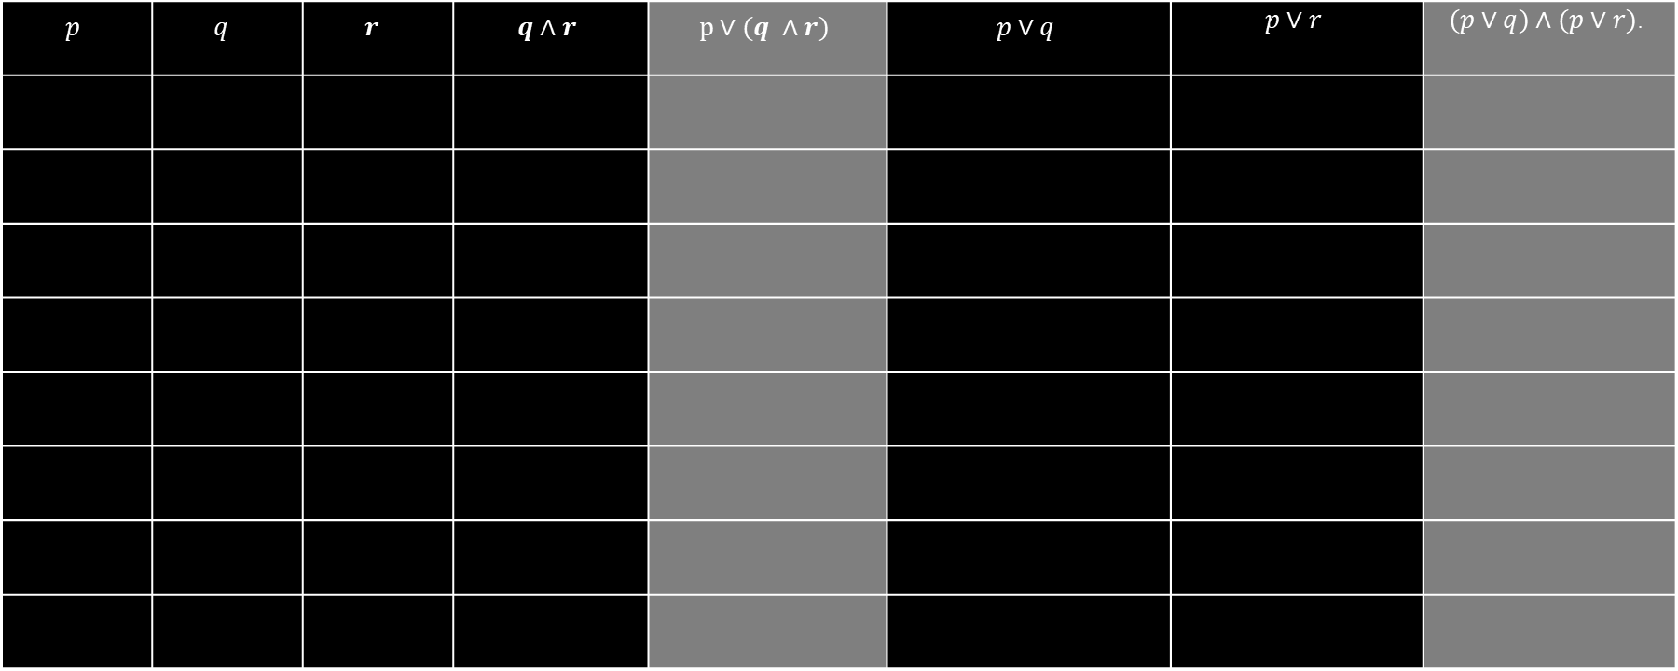
Practice
Determine if $p∨(q∧r)$ $≡$ $(p∨q)∧(p∨r)$.
$$p$$ | $$q$$ | $$r$$ | $$q∧r$$ | $$p∨(q ∧r)$$ | $$p∨q$$ | $$p∨r$$ | $$(p∨q)∧(p∨r)\text{.}$$

Slide 6
Up Next…
Key logical Equivalences Including De Morgan’s Laws

